Slide 1

National University of Management
Faculty of Information Technology
Deep Learning Project Presentation
“Khmer Handwritten Digit Recognition Using Deep Learning”
A Presentation by
THON Saksambo
Khum Svet
Hon Somaly
Sing Huyleang
Chheng Torhov

Slide 2


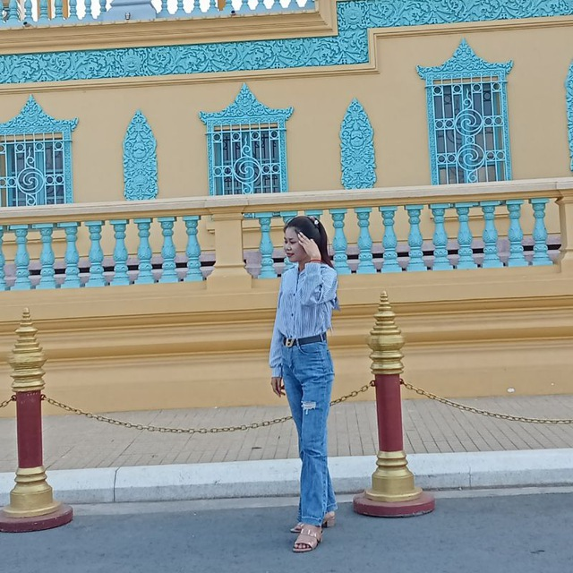


Presented by….
CHHENG Torhov
THON SAKSAMBO
KHUM SVET
HON SOMALY
SING HUYLEANG
CHHENG TORHOV

Slide 3

CHHENG Torhov
Acknowledgement
Family: Our deep and sincere gratitude goes to our family.
Professor: We would like to express our special thanks and gratitude to Professor Kong Chanphanith.
Our Team: We would also like to thank our friends who helped us finish this project within a limited time. Their support significantly increased our knowledge and skills.

Slide 4

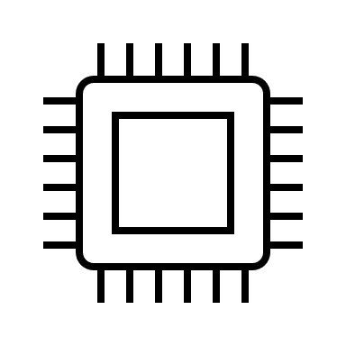


CHHENG Torhov
Chapters
1
2
3
4
Introduction
Technology Overview
System Analysis and Design
Conclusion

Slide 5
HON SOMALY
1. Introduction

Slide 6
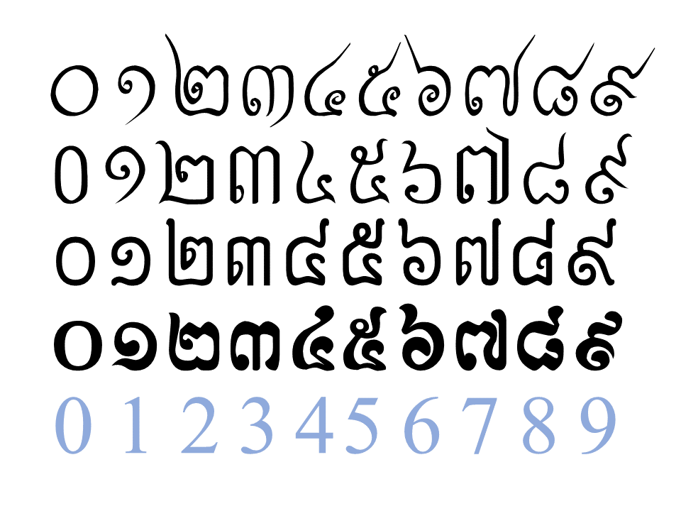
HON SOMALY
1. Introduction
Background of Study
Khmer digits are commonly used in education, forms, and signage in Cambodia.
However, digital systems rarely support automatic recognition of Khmer handwritten digits.
Digit recognition (especially for non-Latin scripts) is important for OCR, digitization, and AI applications.
Khmer Numerals
By Cambodia Public Domain - Own work, CC BY-SA 4.0, https://commons.wikimedia.org/w/index.php?curid=93227246

Slide 7
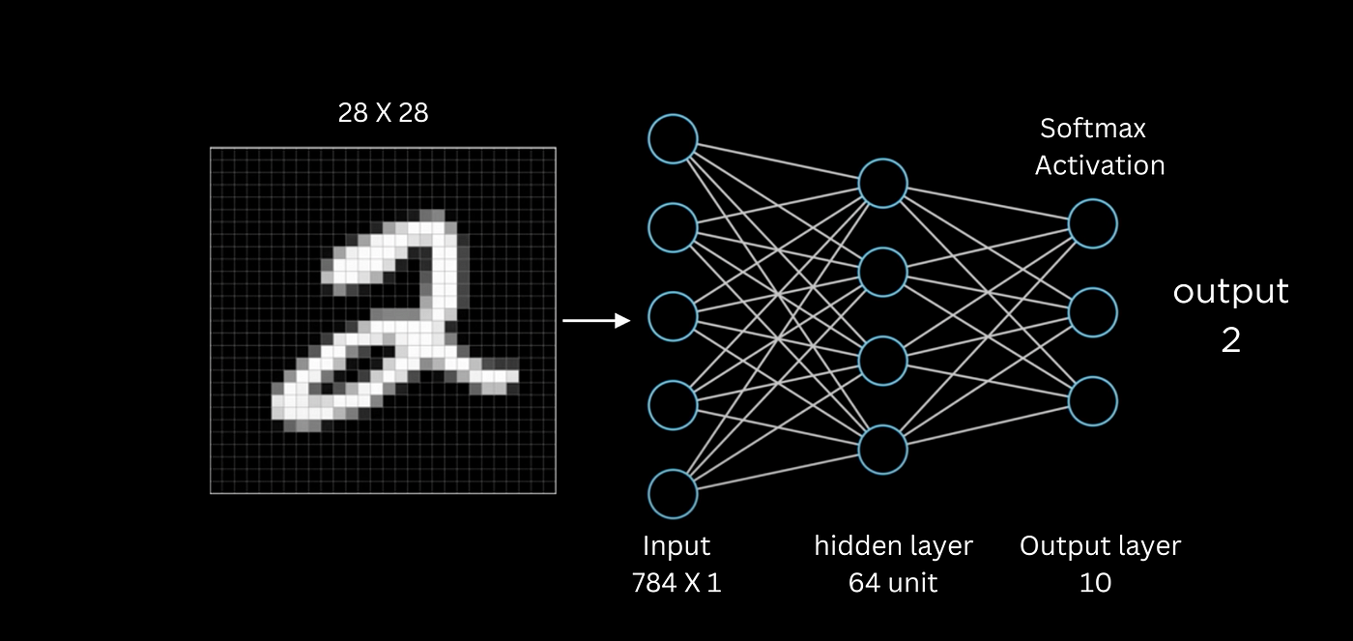
HON SOMALY
1. Introduction
Problem Statement
No widely accessible tool for recognizing handwritten Khmer digits.
Existing models (like MNIST) focus only on Latin numbers.
Lack of digit recognition limits the use of AI in Khmer contexts.
MNIST digit classification (medium.com)

Slide 8

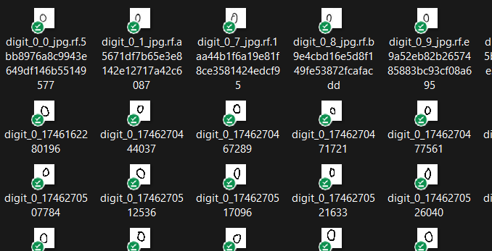
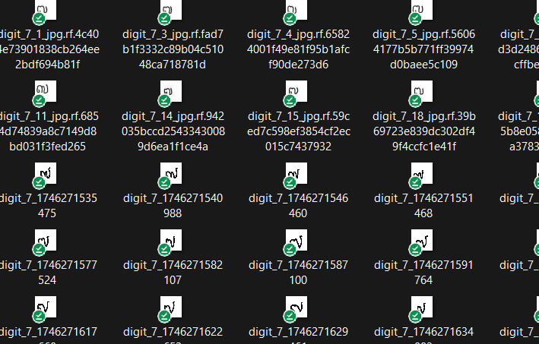
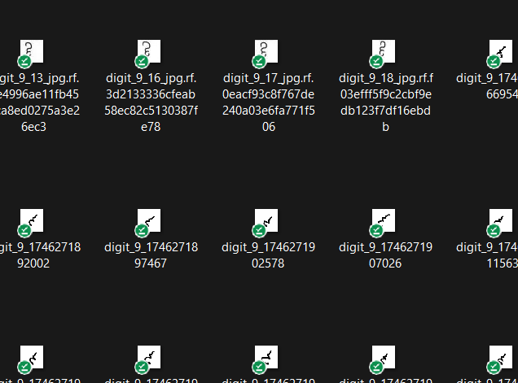
HON SOMALY
1. Introduction
Objectives
Build a web-based system to recognize Khmer handwritten digits.
Train a machine learning model using a custom dataset.
Support both real-time drawing and image upload for prediction.
web-based system
Custom dataset

Slide 9
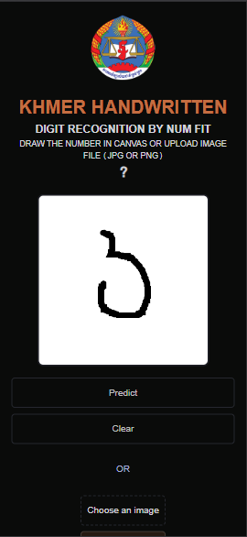


HON SOMALY
1. Introduction
28
28
Scope
Digits only (0–9) in Khmer script.
Image format: grayscale, 28x28 size.
Web interface, backend using Python (Flask/TensorFlow).
Limited to digit recognition (not full OCR or sentences).
Grayscale Pixels
Web interface →

Slide 10
SING HUYLEANG
2. Technology Overview

Slide 11
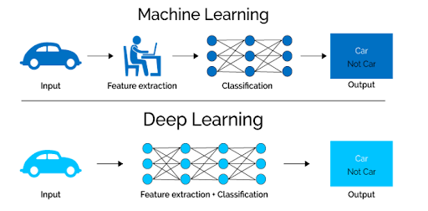

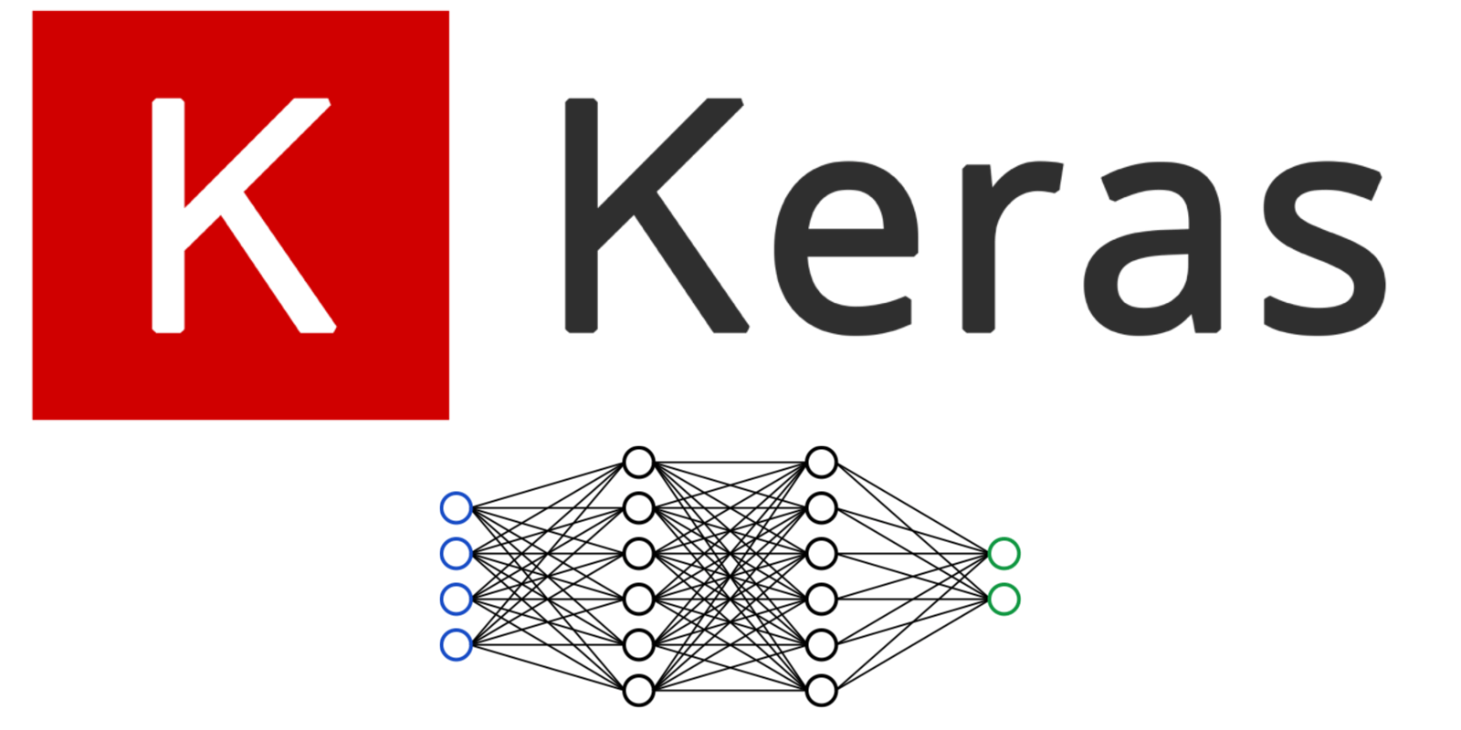
SING HUYLEANG
2. Technology Overview
Global Trends
Handwritten digit recognition (e.g., MNIST) is foundational in AI education.
Deep learning and CNNs dominate modern image classification tasks.
TensorFlow and Keras are widely used for quick prototyping and deployment.

Slide 12
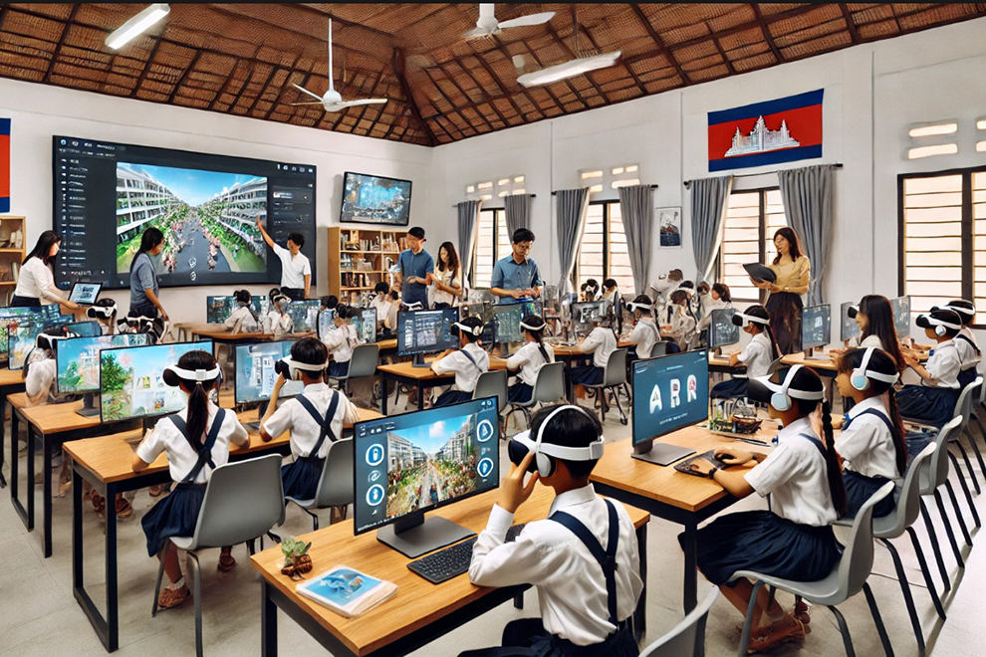
SING HUYLEANG
2. Technology Overview
Local Trends
Increasing AI interest in Cambodia, especially in academia.
Lack of open Khmer datasets and tools.
Growing use of Khmer Unicode, but few machine learning applications exist yet.
AI generated about Cambodia’s AI education Image, Source: Phnom Penh Post

Slide 13
SING HUYLEANG
2. Technology Overview
Relevant Theories (TAM)
Perceived Usefulness: Useful for digitizing Khmer data.
Ease of Use: Simple UI with canvas and upload.
Attitude Toward Use: Encouraging in education and digitization contexts.
AI generated about Cambodia’s AI education Image, Source: Phnom Penh Post

Slide 14
THON SAKSAMBO
3. System Analysis and Design

Slide 15
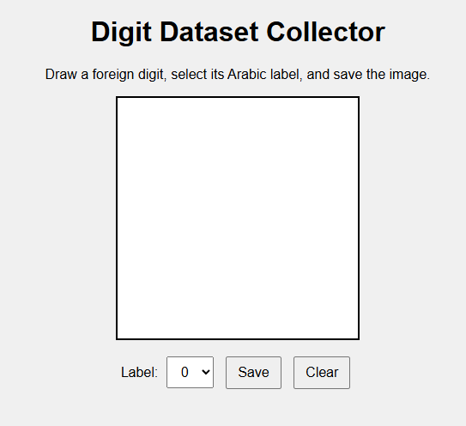
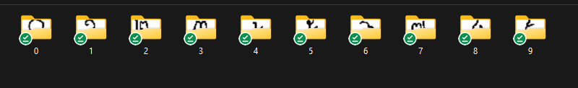
THON SAKSAMBO
3. System Analysis and Design
Planning
Planned to build a digit recognizer specifically for Khmer script
Manual data collection from a simple HTML file, done by our team

Slide 16
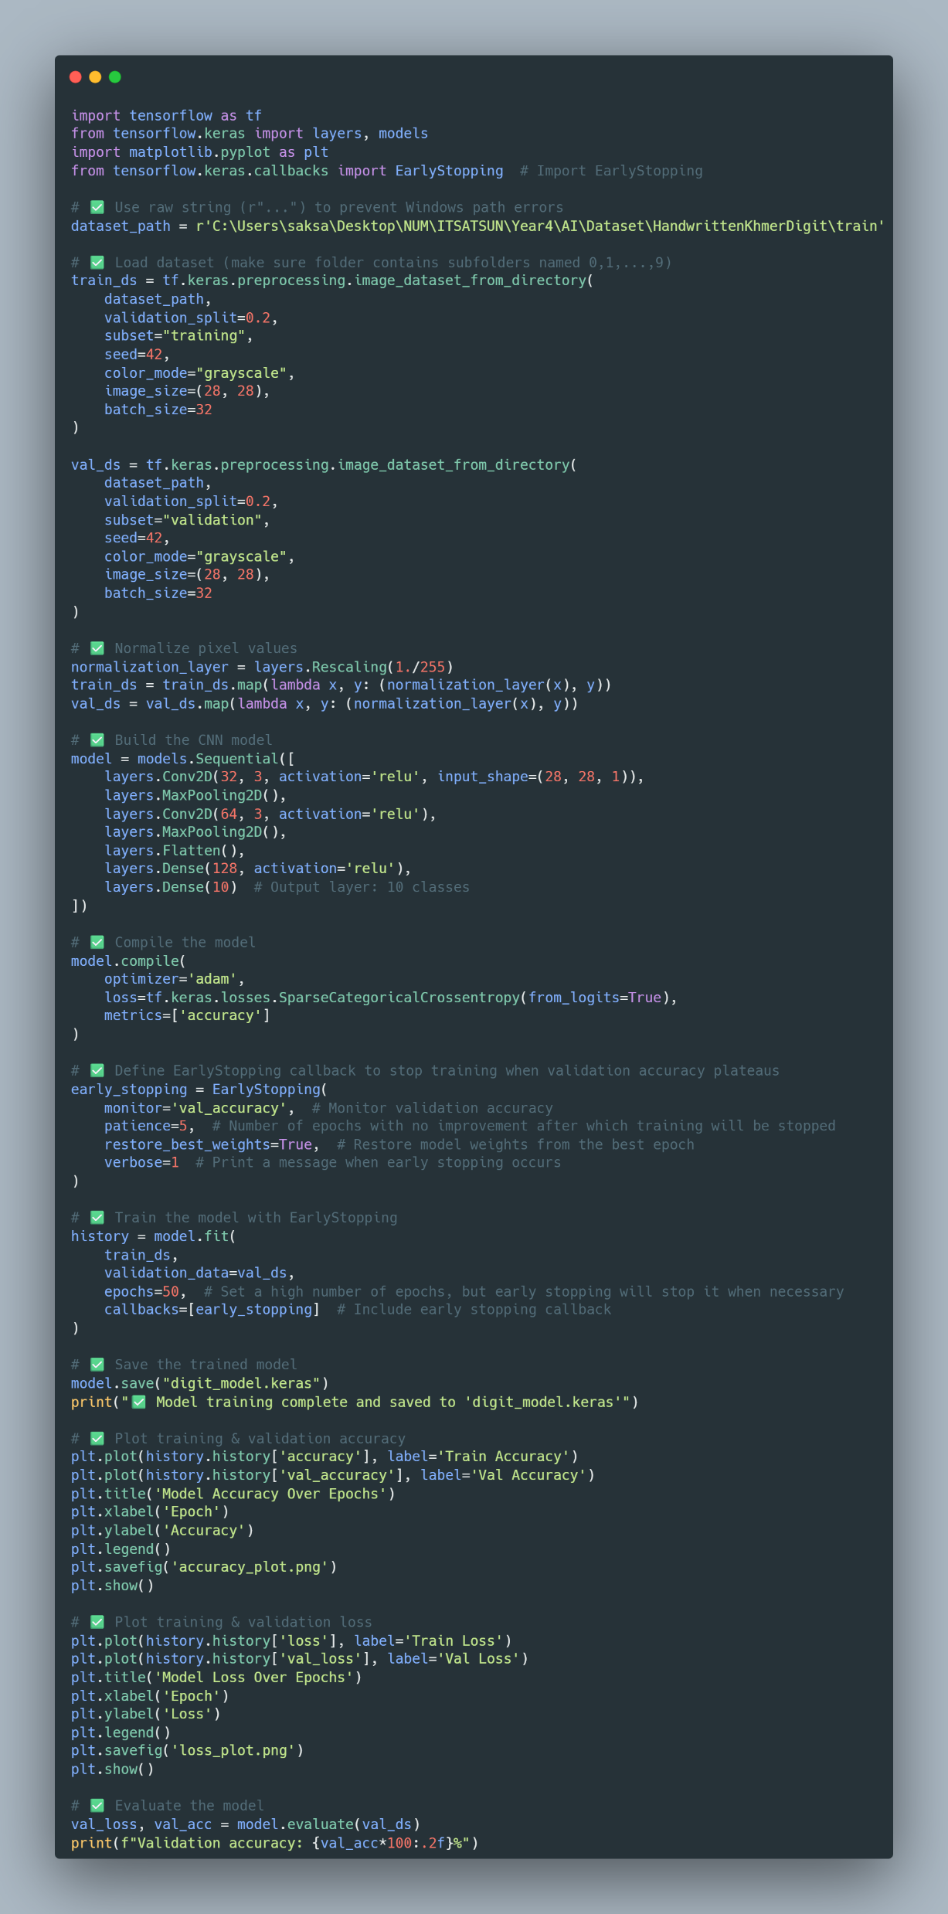
THON SAKSAMBO
3. System Analysis and Design
Analyzing
Investigated image preprocessing techniques (grayscale, resizing, thresholding).
Chose CNN as the core algorithm for classification
Model_train.py →

Slide 17

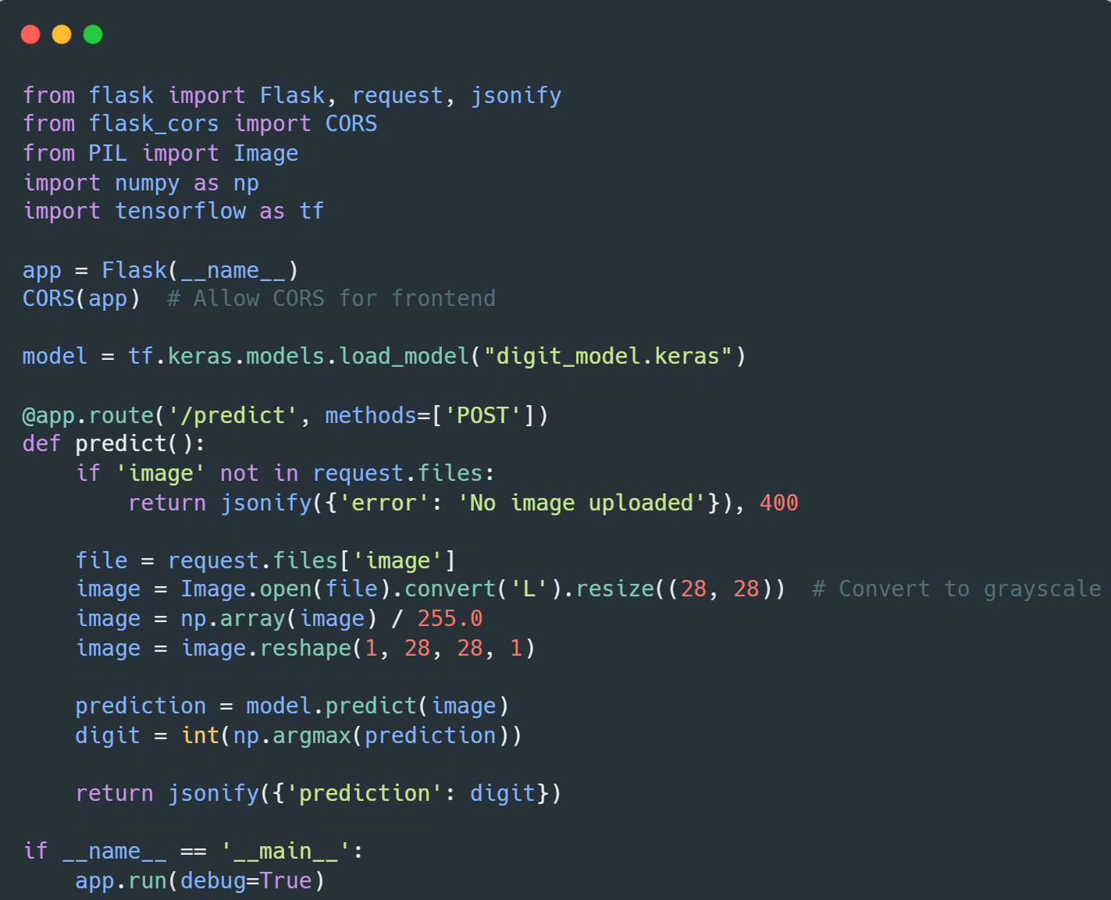
THON SAKSAMBO
3. System Analysis and Design
Frontend
Designing
Dataset: Custom collected digits + digits from the internet (small)
Frontend:
Built with HTML5 Canvas for drawing digits
Support PNG or JPG file uploads
Backend:
Flask API to receive, preprocess and return predictions
Model:
CNN trained on manually collected dataset with 28x28 grayscale images.
app.py

Slide 18
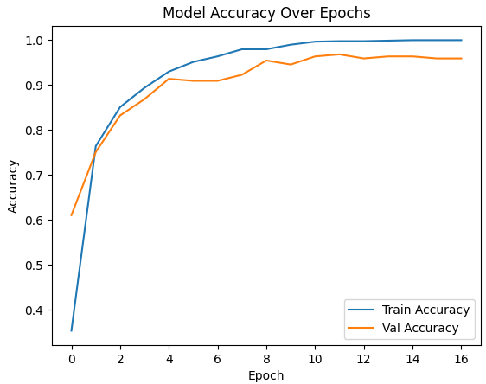
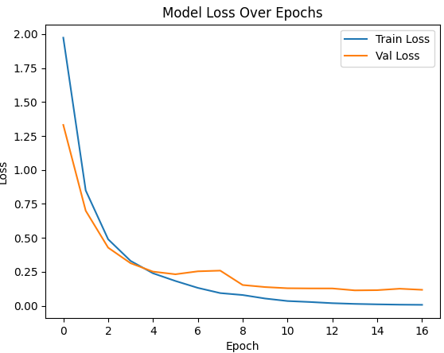
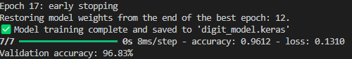
THON SAKSAMBO
3. System Analysis and Design
Implementation
Trained model with 80/20 train-validation split
Integrated with canvas and file-upload frontend
Added prediction display and minor animations for usability
Tested with real user input to verify robustness
Training Results:

Slide 19
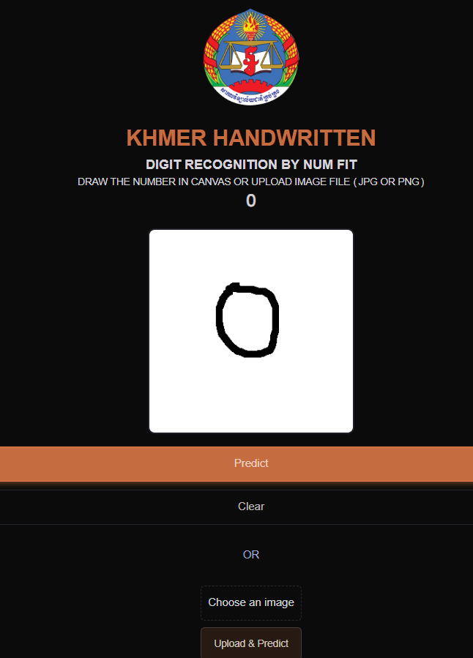
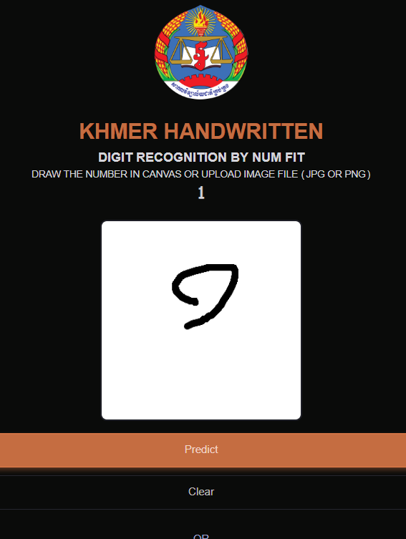
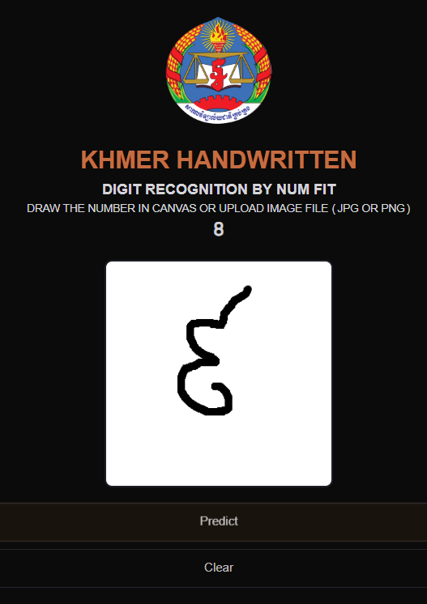
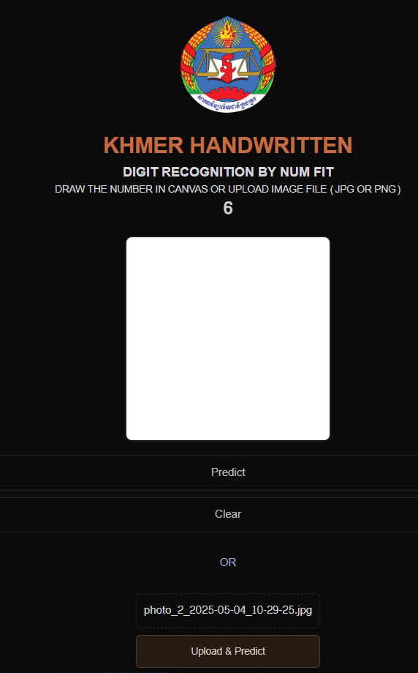
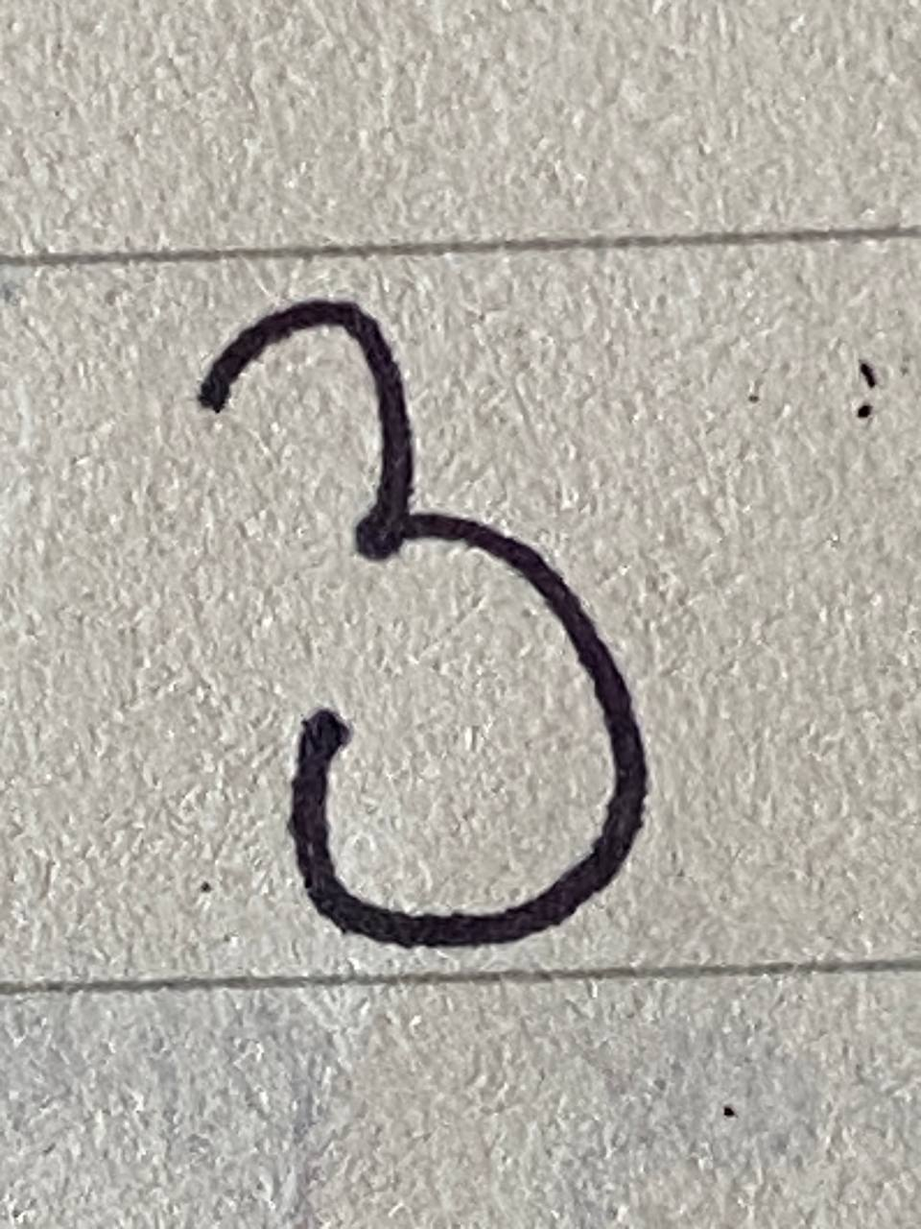


THON SAKSAMBO
3. System Analysis and Design
Implementation
Tested with real user input to verify robustness
←Fail
Real Image upload

Slide 20
THON SAKSAMBO
Demo

Slide 21
KHUM SVET
4. Conclusion

Slide 22

KHUM SVET
4. Conclusion
Recommendations, Suggestions, Future Work
Collect more diverse handwriting samples from different demographics.
Consider augmenting the dataset for better generalization.
Improve model architecture or use pretrained models.
Host the application online or package it into a mobile app.

Slide 23
KHUM SVET
4. Conclusion
Conclusion
Successfully built a functional Khmer digit recognition system.
Created our own dataset from scratch to support training.
Deployed a usable web interface connected to a CNN model.
A strong foundation for future AI projects involving the Khmer language.

Slide 24

Thank You!!!

